Slide 1
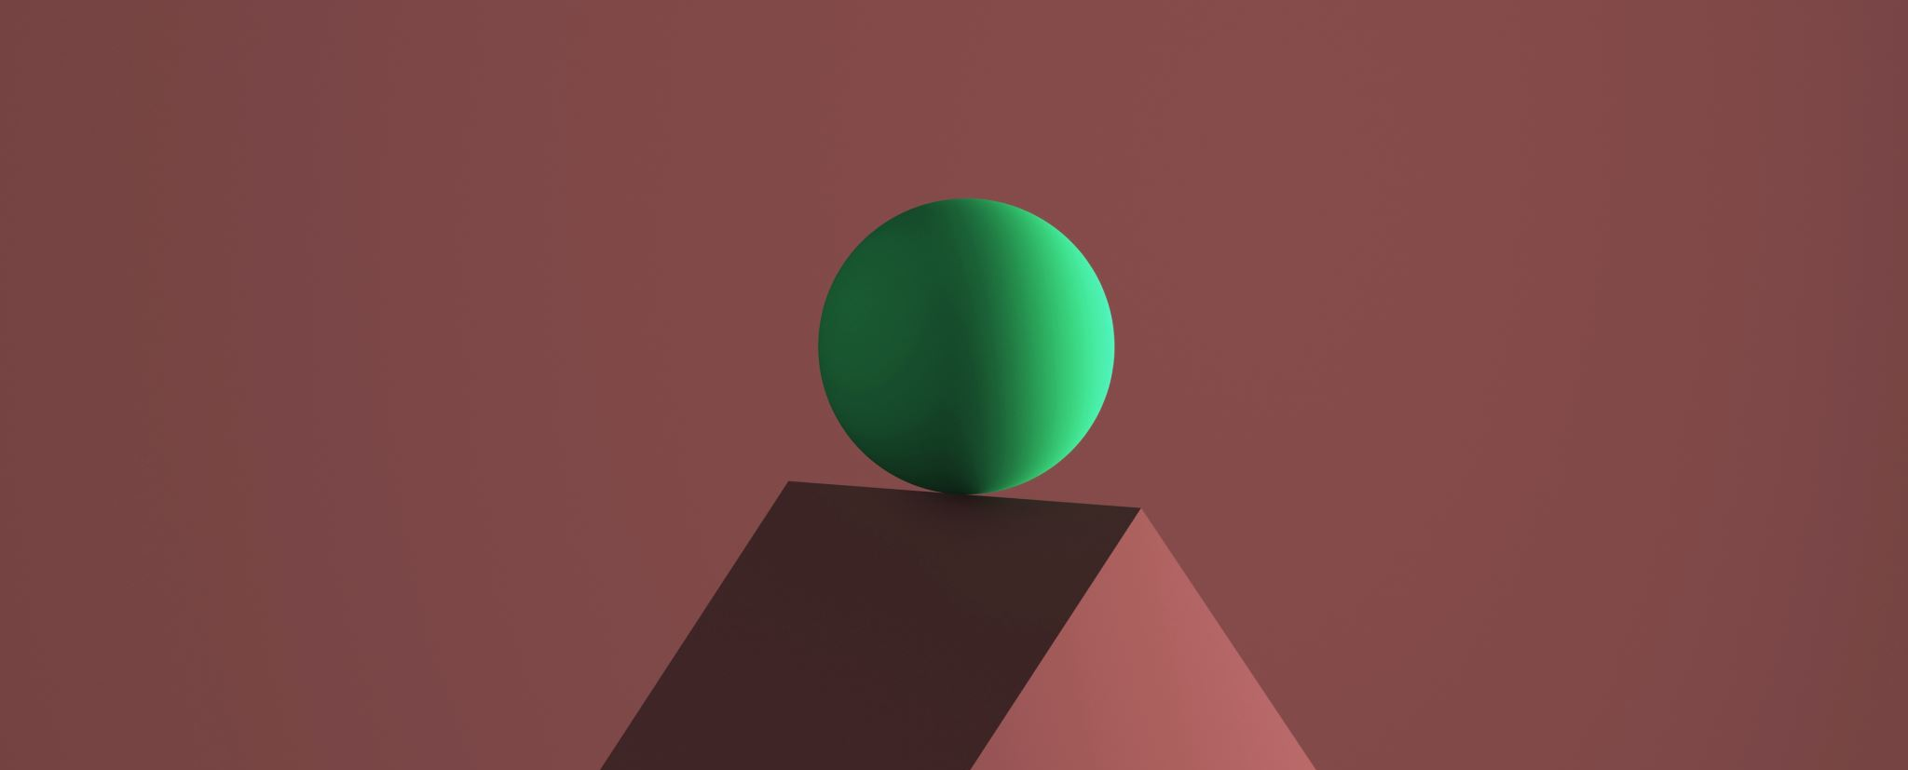
Collision tutorial
This is how to make your projectiles collide with any 3D object

Slide 2
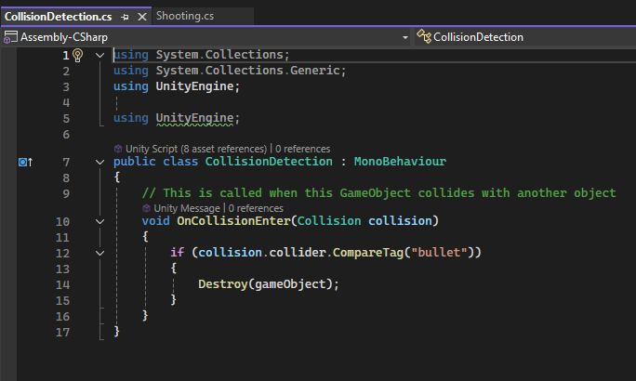
Collision script
So far, the 3D objects that should have been made are the gun, player and some boxes for the projectiles to collide with.
Writing public class CollisionDetection : MonoBehaviour is a way to define a custom script.

Slide 3

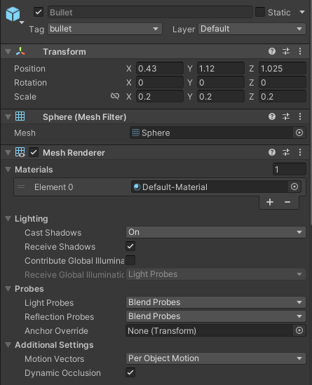
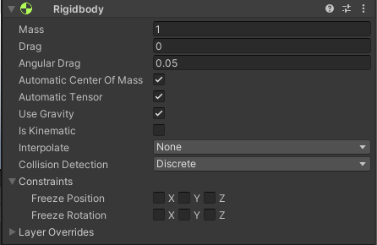
Inspector in Unity
The features for inspector are that you can edit and customize which allows you to modify components and variables.
For making a projectile shoot you must make sure that Use Gravity, Automatic Tensor and Automatic Centre Of Mass are ticked. This will make sure when the projectile shoots, it does not float, and it shoots to the centre.

Slide 4
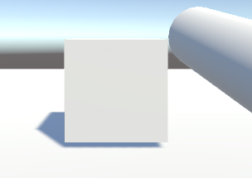

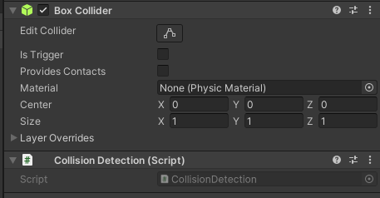
Hitting the objects
You should first start by adding a box collider
To make a box collider you can search box collider in the inspector
Next you should add the collision script to the object you want hit
Duplicate the object you want collision with
And when you play the game, the projectiles should be colliding with the objects you set it to.

